Slide 1


The Canadian Children’s Optimist Foundation
Helping your Optimist Club
Help More Children

Slide 2

YOU SAID CCOF??
CANADIAN CHILDREN'S OPTIMIST FOUNDATION
Our mission is to seek, receive and manage funds, real and personal property, and to hold and administer that property exclusively to support Optimist International (OI) and its Member Clubs in Canada promoting and encouraging Canadian youth….
AND HELP YOU HELP MORE KIDS!

Slide 3
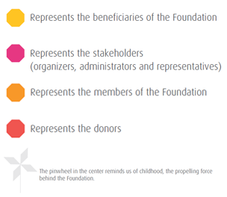
OUR LOGO
The Canadian Children’s Optimist Foundation’s log is made of four Optimist octagons, each of them representing one aspect of the Foundation.

Slide 4
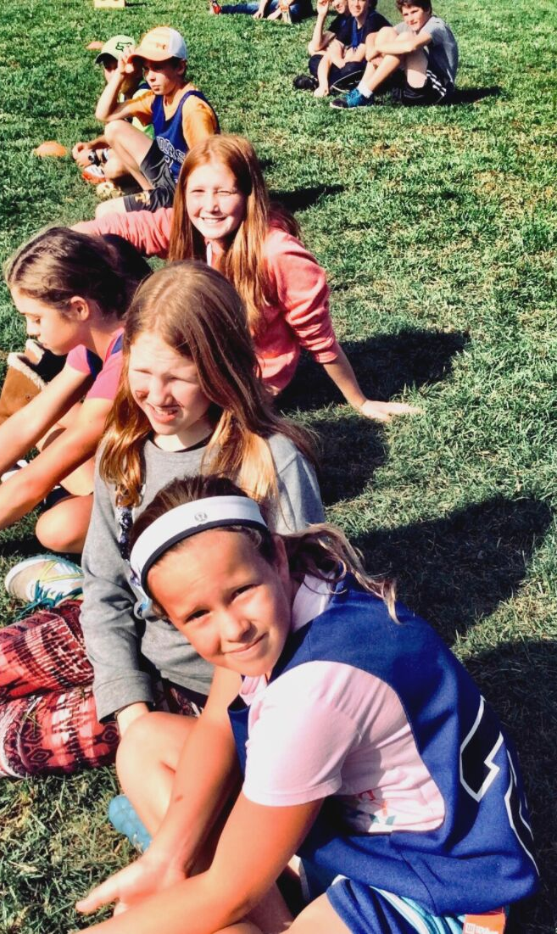
OUR SERVICES
OUTSOURCING PROGRAM
What if you could offer a tax receipt to your donors?
The purpose of the Outsourcing Program is to help the Clubs optimize the fundraising efforts of their charitable activities by using the Canadian Children's Optimist Foundation resources:
  Tax Receipts
  Online Payment
  Credit Card Payment

Slide 5
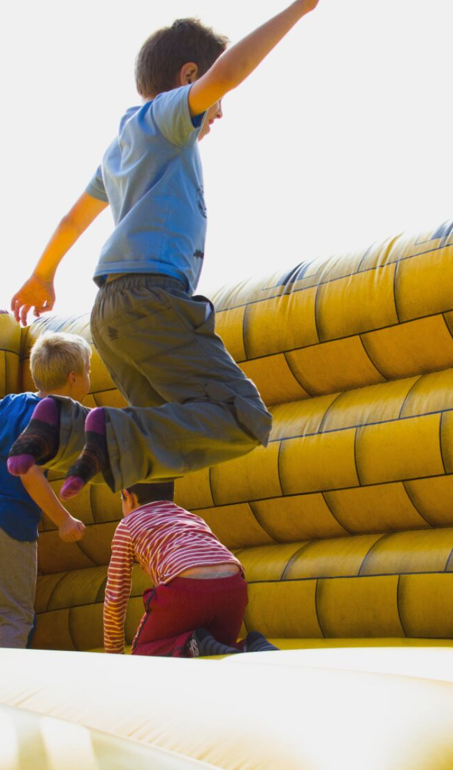
CCOF Club Grants
The Canadian Children's Optimist Foundation is offering grants up to $1,000.00 for one of your Club's community projects.
Goal of the Community Project:
Promote and encourage the education , health, social, artistic or physical development and growth of Canadian youth.
Bring about the relief of poverty and its adverse effects upon Canadian youth
Deadline: March 31st

Slide 6

Spread Relief Program
Spread Relief provides grants up to $3,000.00 quarterly to selected Optimist Clubs across Canada, for childhood health and wellbeing related projects:
  Assist children and families dealing with mental and physical health issues;
  Help families cope with the diagnosis and treatment of their child's illness or disability;
  Promote and raise awareness on the benefits of a healthy lifestyle among youth.
  Deadlines: November 30, February 28, May 31 and August 31

Slide 7
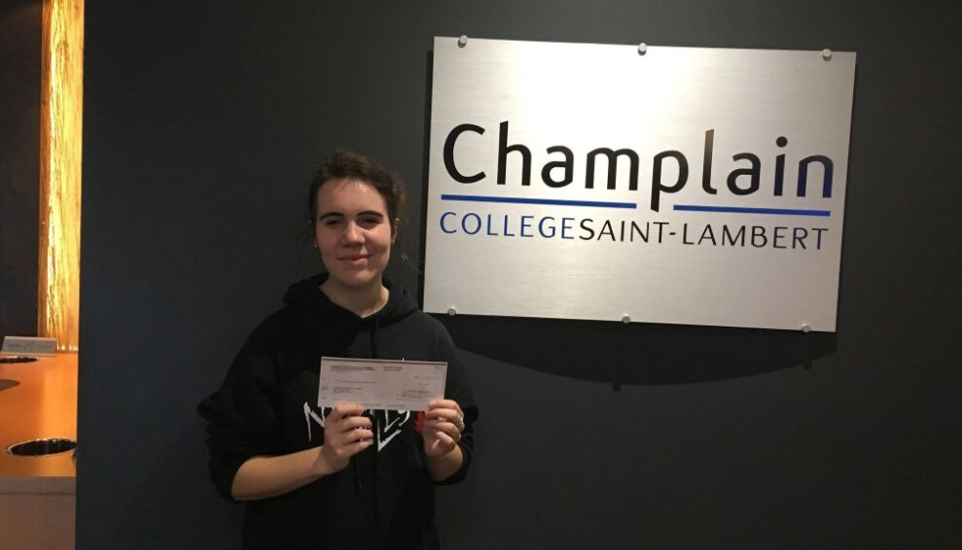
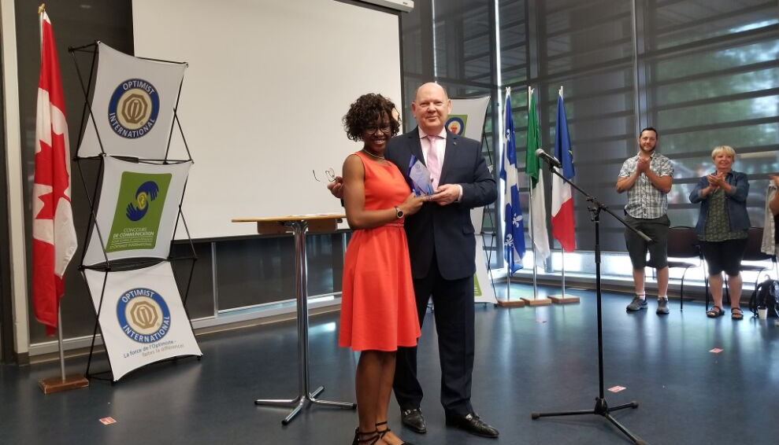
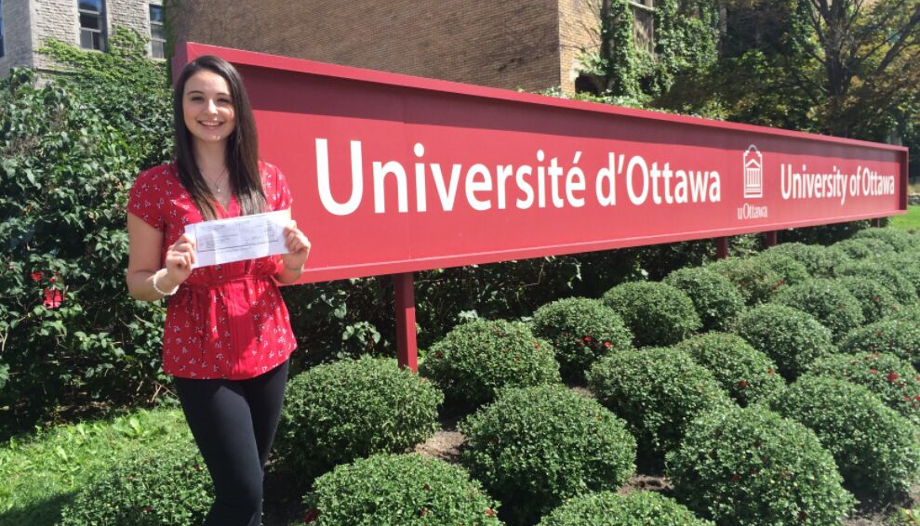
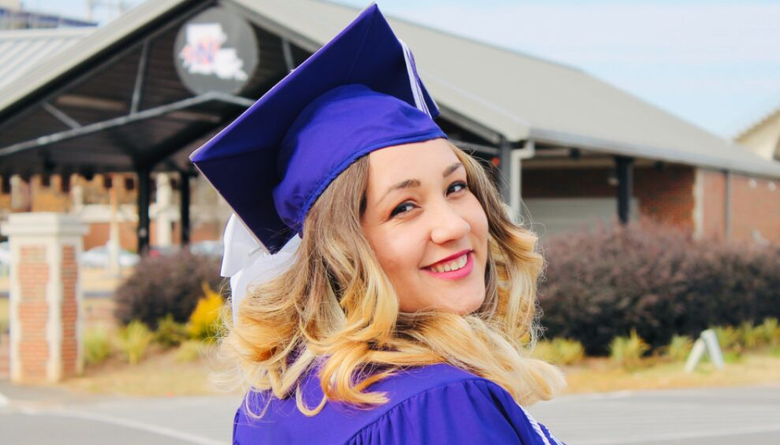
OI SCHOLARSHIPS
  Oratorical
  Essay
  CCDHH

Slide 8
We Are Listening
Membership Survey Results:
As clubs move away from an awards banner and as we continue to manage our resources responsibly, we are considering replacing our banner patch with a certificate of recognition available either online or in print (to be processed by a CCOF staff member). How would you like to receive your certificate?

Slide 9
Membership Survey Results:
We are also exploring the option of a virtual patch that could be displayed on club websites, social media and other digital and printed materials. Is this an option you would like to have?
        Yes 83%
        No 17%
When memorializing or recognizing an individual how should we notify the family of the loved on or the person being honoured?
Letter or Card by Mail 75%
Letter by Email 25%

Slide 10
Membership Survey Results:
As the Canadian Children’s Optimist Foundation, we want to share occasional updates without overwhelming your inbox. How frequently would you like to receive these updates?
        Monthly 32%
        A few key updates per year (2-3 times) 39%
        Occasional news when something important happens 25%
        I prefer not to receive updates 4%

Slide 11

What does all of this mean??
Canadian Children’s Optimist Foundation is the charity of choice for our members.
Our donations increase and we give away more money

Slide 12

HOW CAN WE HELP YOU?

